Slide 1

Project Proposal
Presented by: Chandana MN
Under the guidance of: Geethamurthy S.B Sir

Slide 2

Digitalization of Check Sheets

Slide 3

What is a Check sheet ?

Slide 4
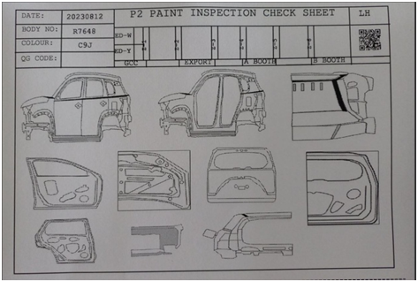
Upgrade check sheet

Slide 5
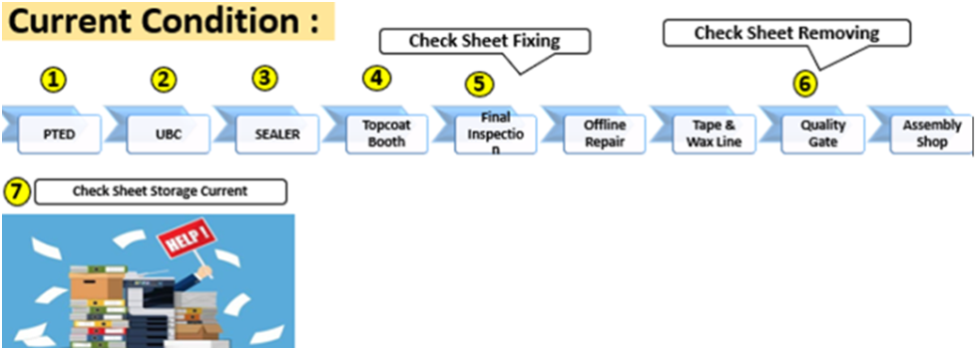

Slide 6
Problem Statement
Current System of Hardcopy Document Management is not Suitable for High Volume Production.
a) Longer lead time for investigation & action during defect outflow.
b) Hardcopy/Document misplace /miss due to multiple handling in different locations.
c) Space constraint for document storage (retention period 2 yrs)

Slide 7
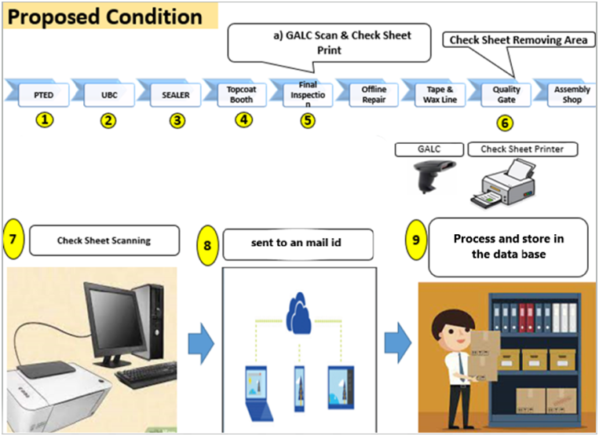

Slide 8
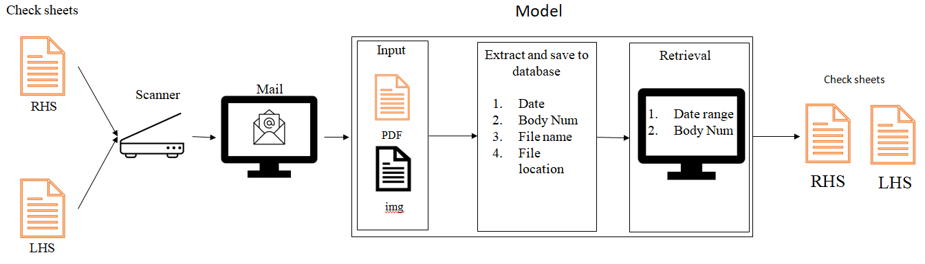
Flow Diagram

Slide 9
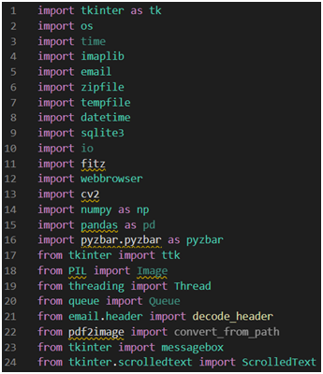
implementation

Slide 10

Interface demo

Slide 11
Advantages
Easy storage of data.
Less time consumption.
Less manpower required.

Slide 12

Thank you for your time

